Slide 1
AI Applications in Marketing & Finance
Introduction to AI Applications
Kartik Hosanagar, Professor of Operations, Information and Decisions

Slide 2
Course Introduction
AI Applications in Marketing Function and in the Financial Services Industry
AI in Marketing
AI and the Customer Journey
Personalization on the Web
AI in Finance
Discussions with Data and AI practitioners

Slide 3
AI Applications in Marketing & Finance
Introduction
Raghuram Iyengar, Miers-Bush, W’1885 Professor, Professor of Marketing and Faculty Director of Wharton Customer Analytics

Slide 4
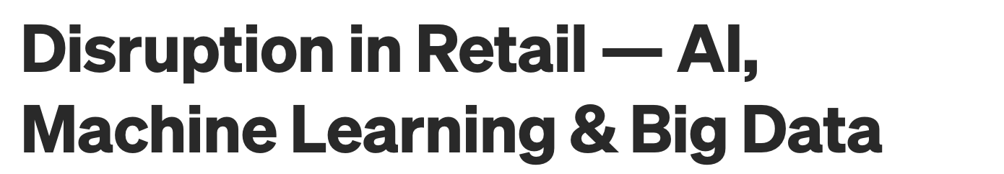
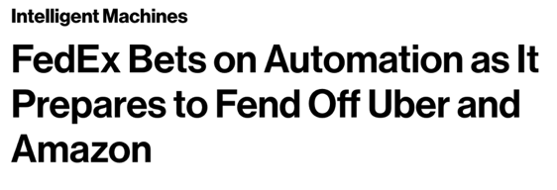
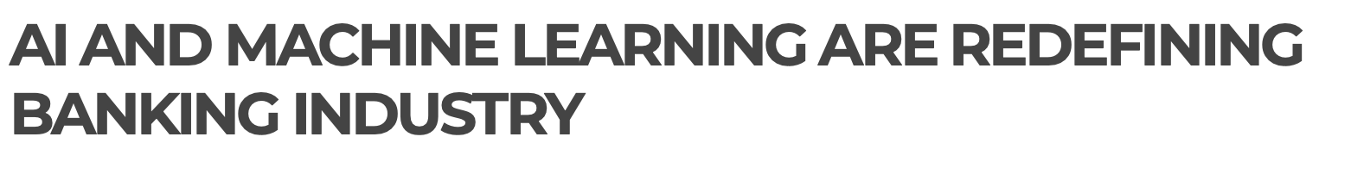
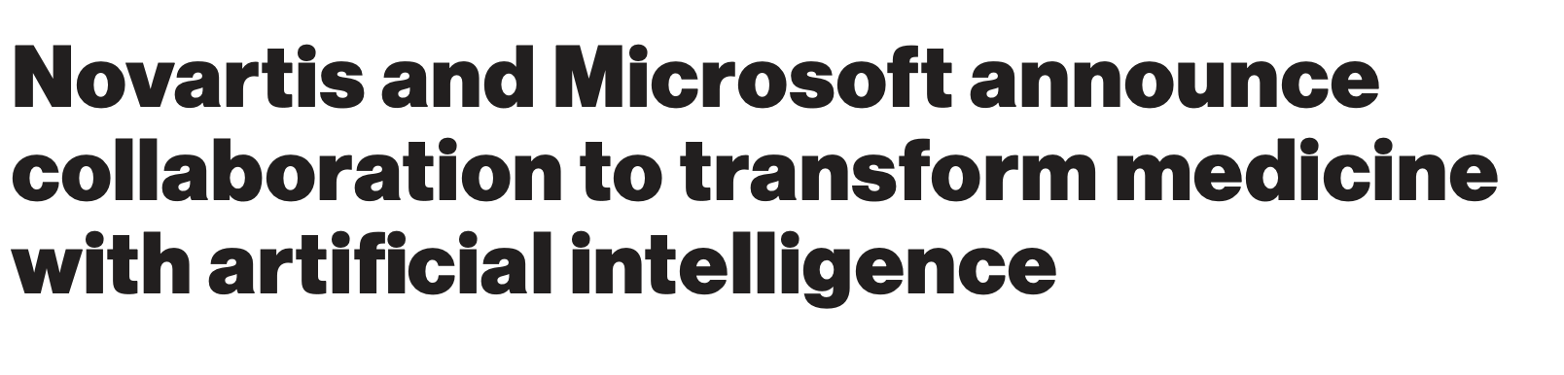
AI Applications are Many

Slide 5
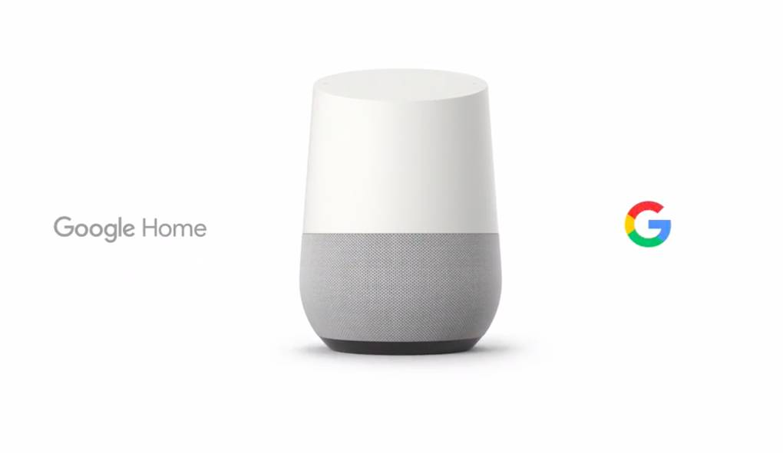
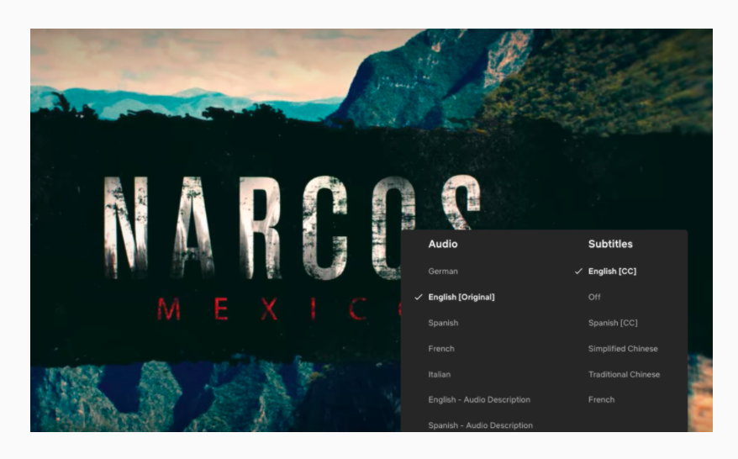

Voice AI

Slide 6
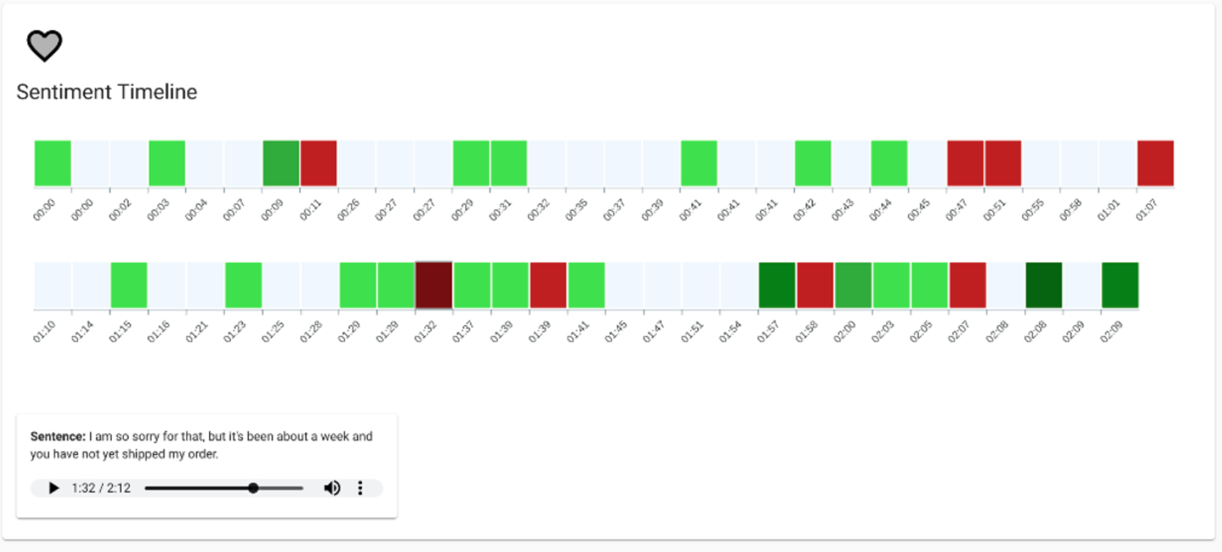
Voice AI

Slide 7

Voice AI

Slide 8
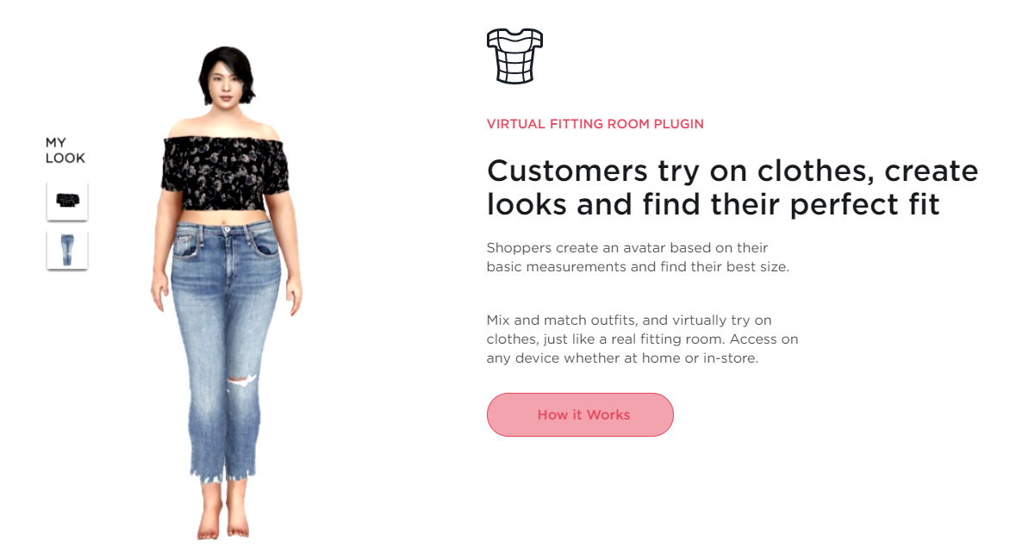
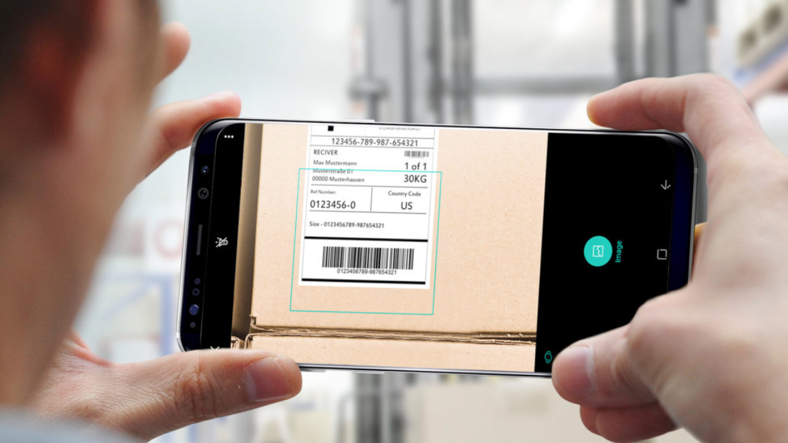
Vision AI

Slide 9

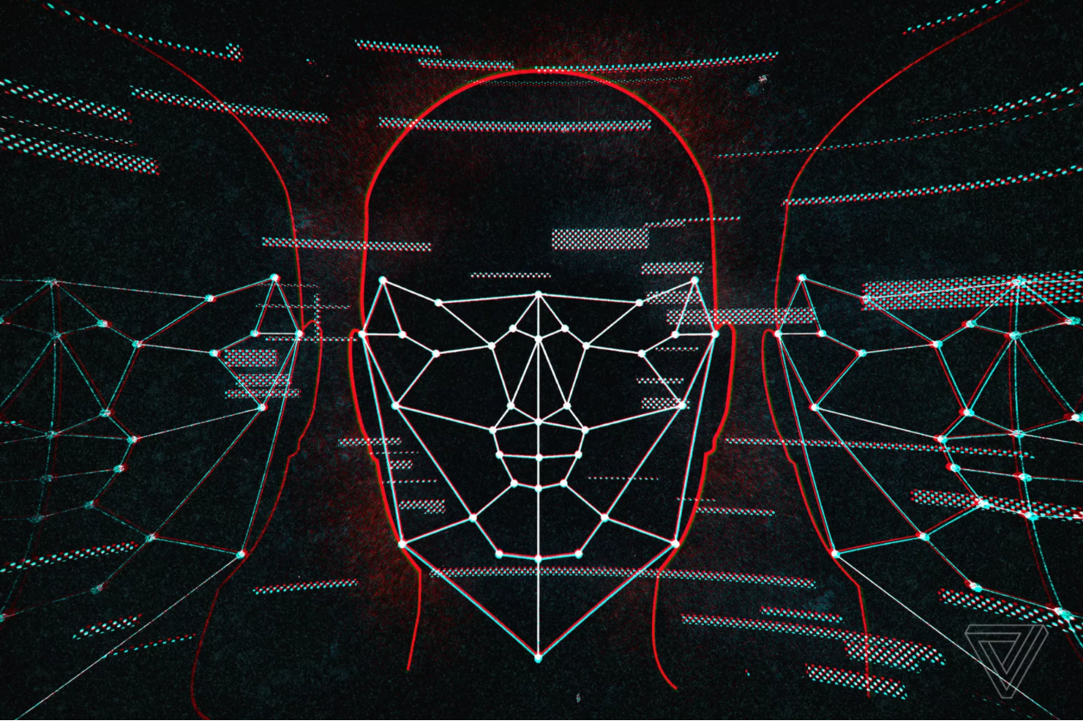
Vision AI

Slide 10
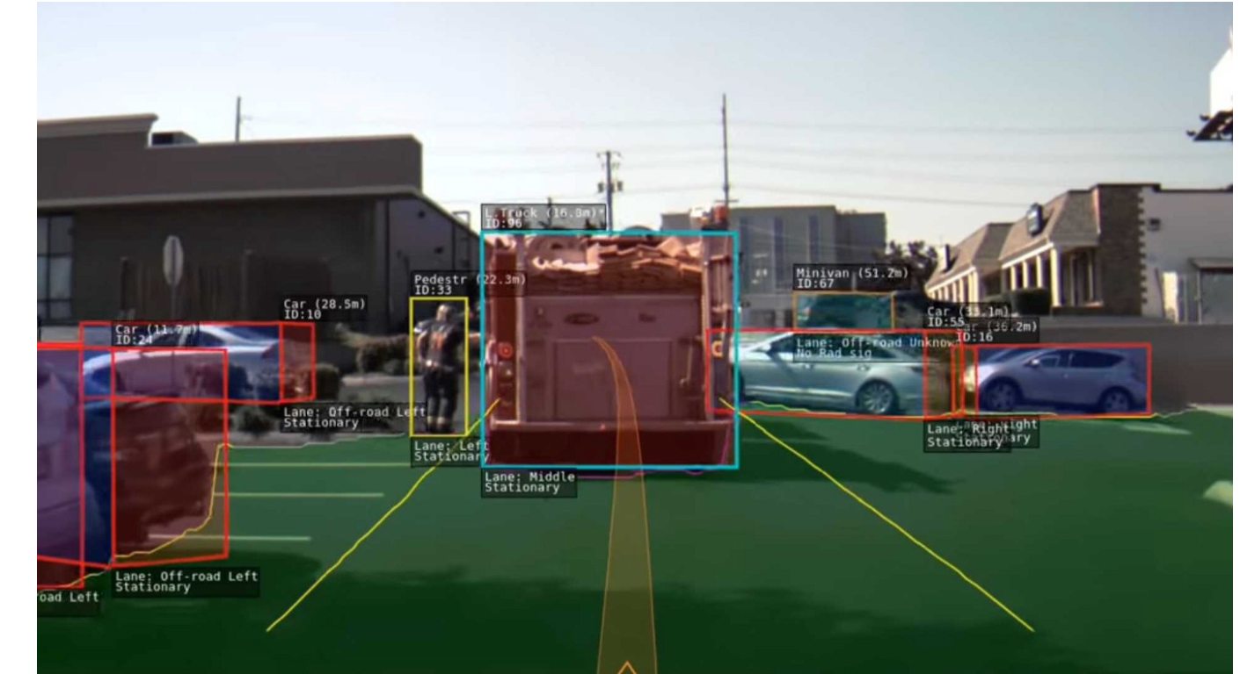

Vision AI

Slide 11
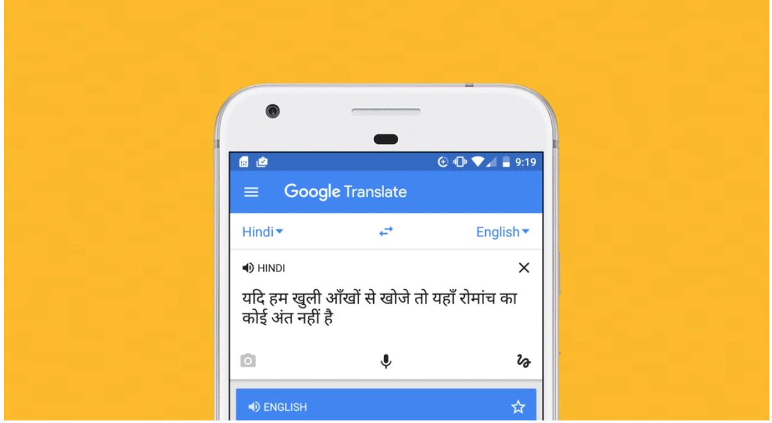
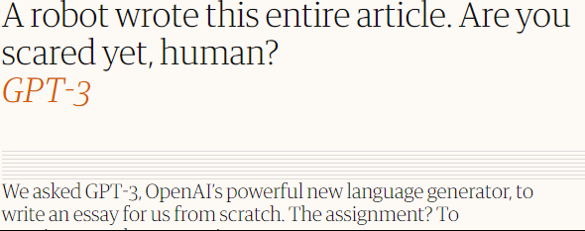
Language AI

Slide 12
AI Applications in Marketing & Finance
Customer Journey
Raghuram Iyengar, Miers-Bush, W’1885 Professor, Professor of Marketing and Faculty Director of Wharton Customer Analytics

Slide 13
“Path to Purchase” (Customer Journey)
Awareness
of Need
Identify
Alternatives
Get Info
About
Alternatives
Evaluate
Alternatives
Purchase
Use
Post
Purchase
Evaluation
If positive
Takeaways
Journey is often quite non-linear
Customer journey + segmentation

Slide 14

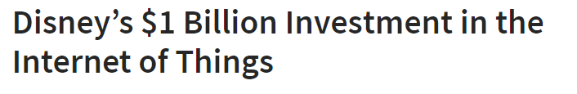
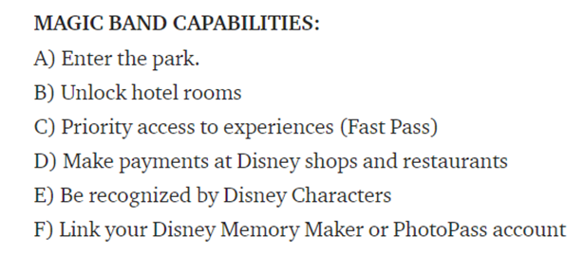
Disney

Slide 15
Why Would Disney Collect this Data?
Operations — traffic flow within the parks and resorts (aggregate level)
Marketing — understand how “customers” go through the parks and resorts, what rides they take (personalized)
New product development
Understanding customer needs and then making the experience seamless

Slide 16

Unilever: Real Time Tracking of Trucks
Why?
Clarity for retailers of when the trucks will arrive
Many retailers buying frequently by less each time
How?
Using ML to tracking where the trucks were going, weather patterns, traffic patterns
Wanted to route trucks in the most efficient manner

Slide 17
Summary
Start with the “why?”
What customer needs are you solving?
Then start thinking about the data assets that are necessary to best solve the problem
Always keep the ROI (return on investment) in sight

Slide 18
AI Applications in Marketing & Finance
Making the Customer Journey Shorter
Raghuram Iyengar, Miers-Bush, W’1885 Professor, Professor of Marketing and Faculty Director of Wharton Customer Analytics

Slide 19
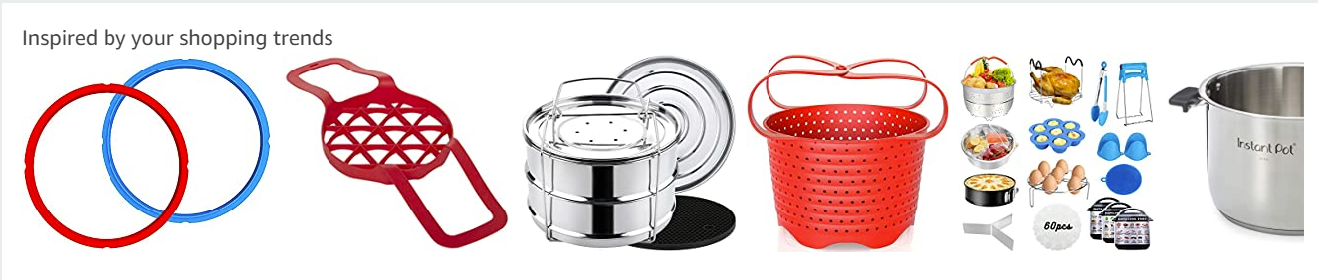
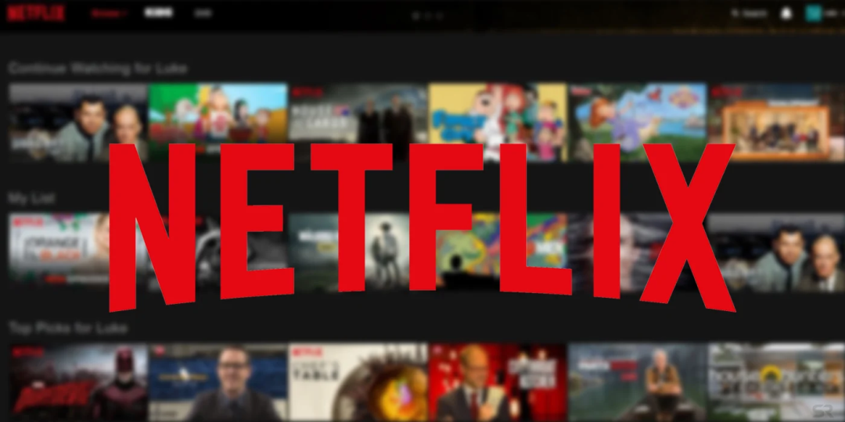

Predicting the Customer Journey

Slide 20
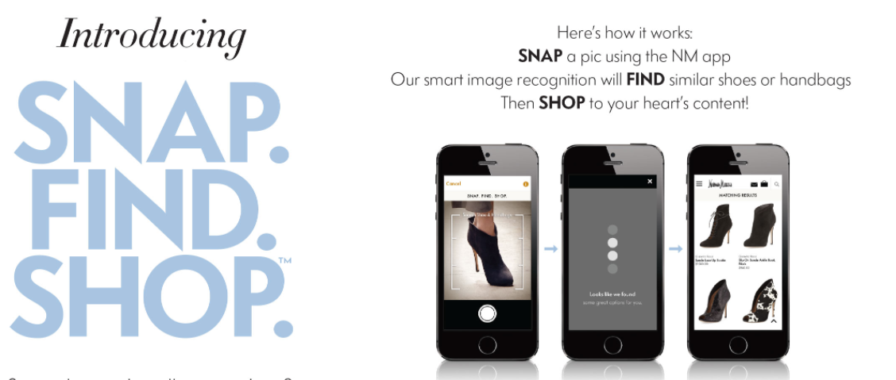

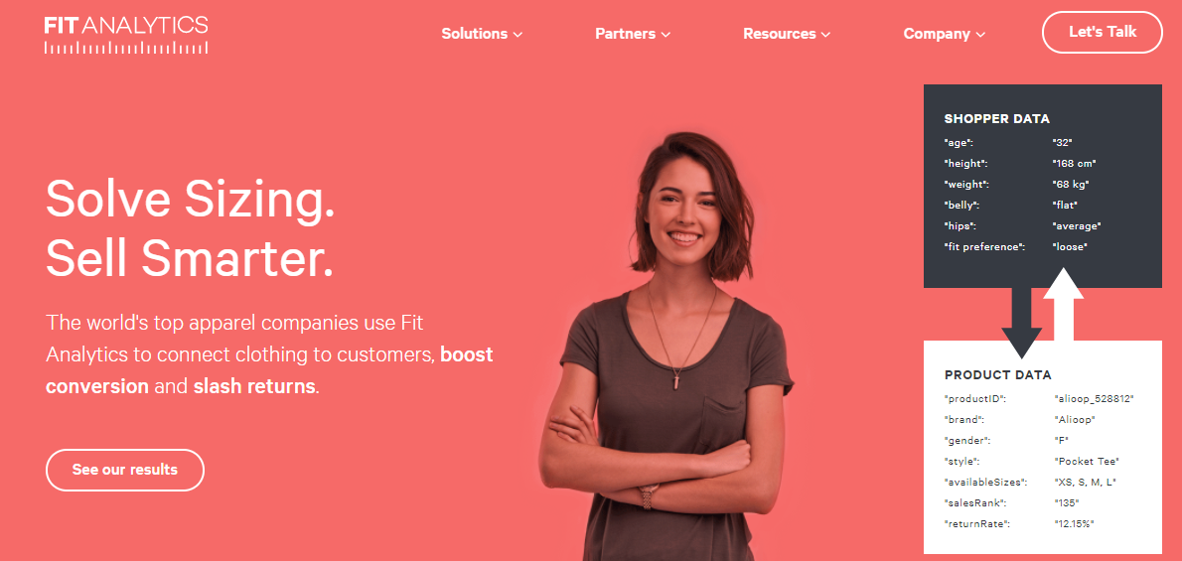
Making the Journey Shorter: Vision AI

Slide 21
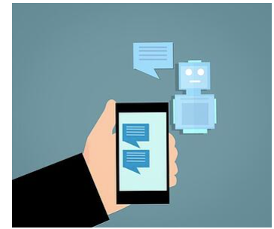
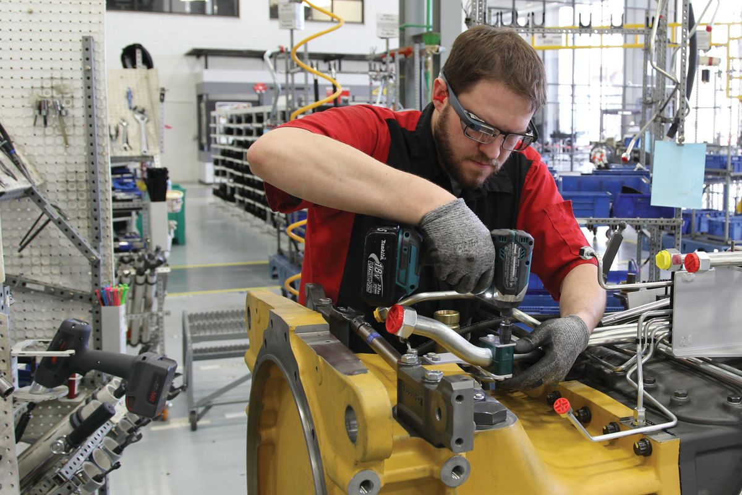
Making the Journey Shorter

Slide 22
Making the Journey Shorter: Voice AI

Slide 23
AI Applications in Marketing & Finance
Moving Upstream in the Customer Journey
Raghuram Iyengar, Miers-Bush, W’1885 Professor, Professor of Marketing and Faculty Director of Wharton Customer Analytics

Slide 24
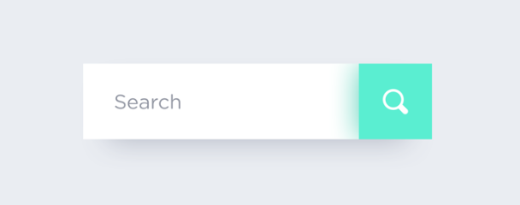
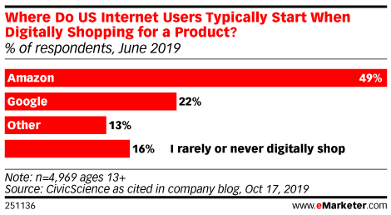
Moving Upstream
Prime Users:
Amazon/Google: 88/12
Non-Prime Users:
Amazon/Google: 50/50

Slide 25
Moving Upstream

Slide 26
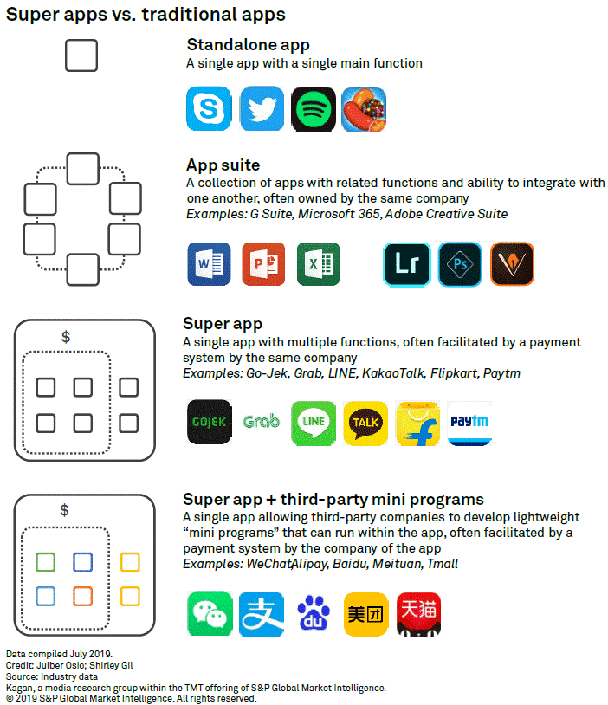

Slide 27

Entertainment

Slide 28
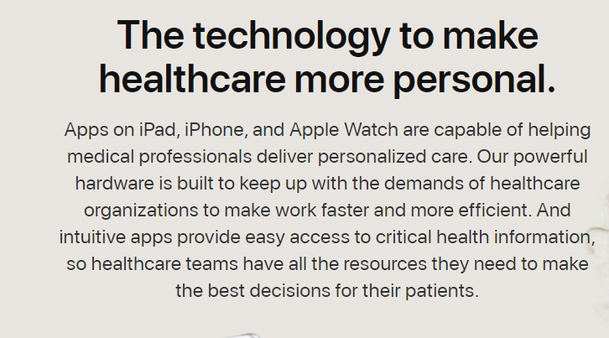
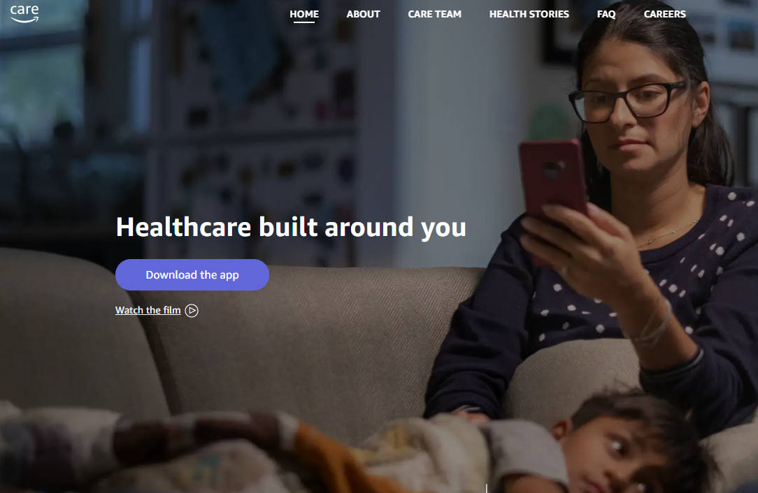
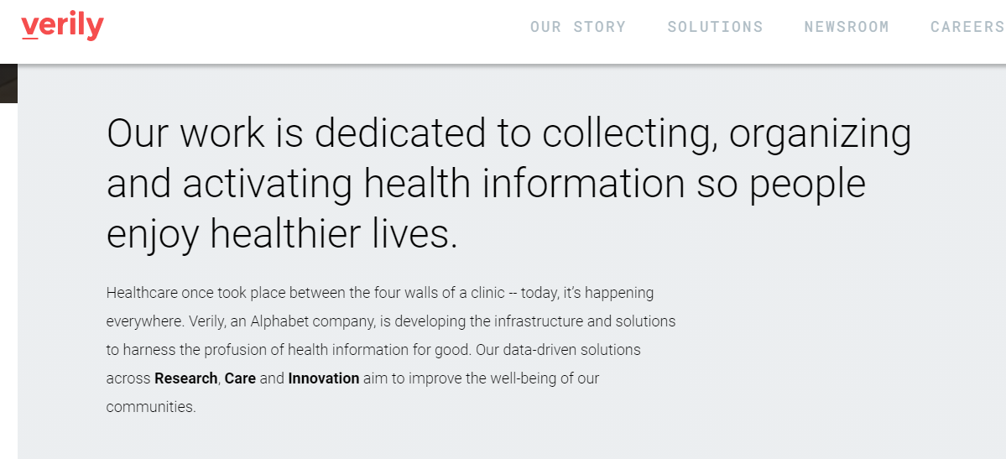
Healthcare - Who Owns the Data?

Slide 29
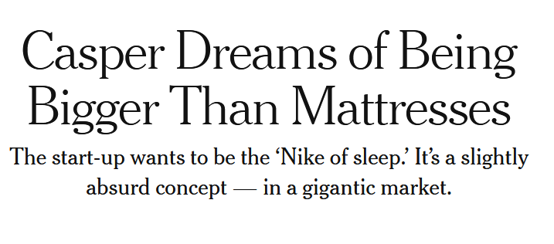
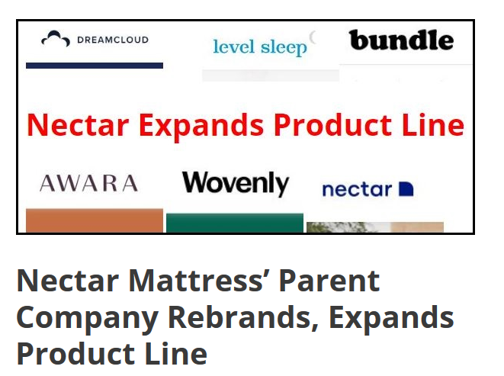
Upstream and Then, Downstream
The customer journey doesn’t stop once somebody purchases
There are other purchases that somebody can make

Slide 30
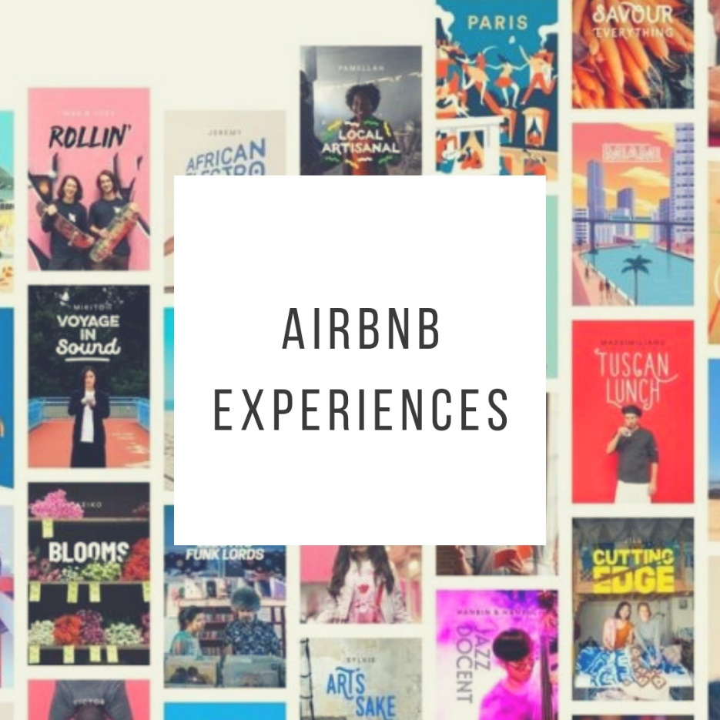
Airbnb Experiences
“For every dollar you spend in a hotel, …, you spend three dollars in the city.…Where you eat, entertainment, what you do all day.
And so we think that’s probably, long term, the biggest opportunity…”
– Brian Chesky

Slide 31
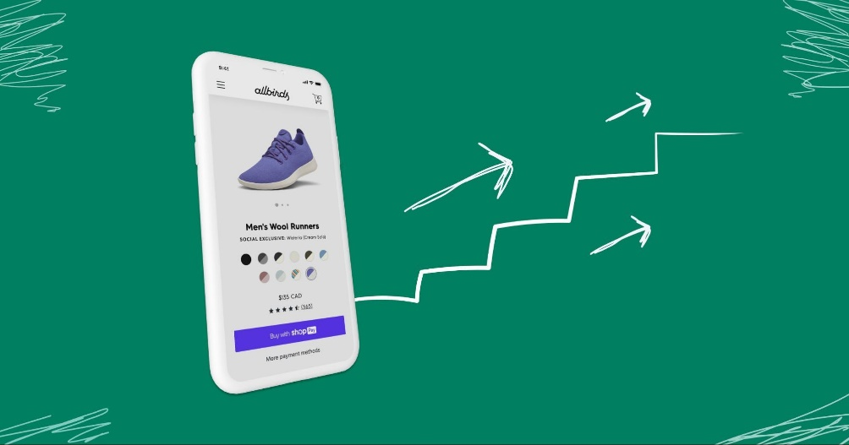
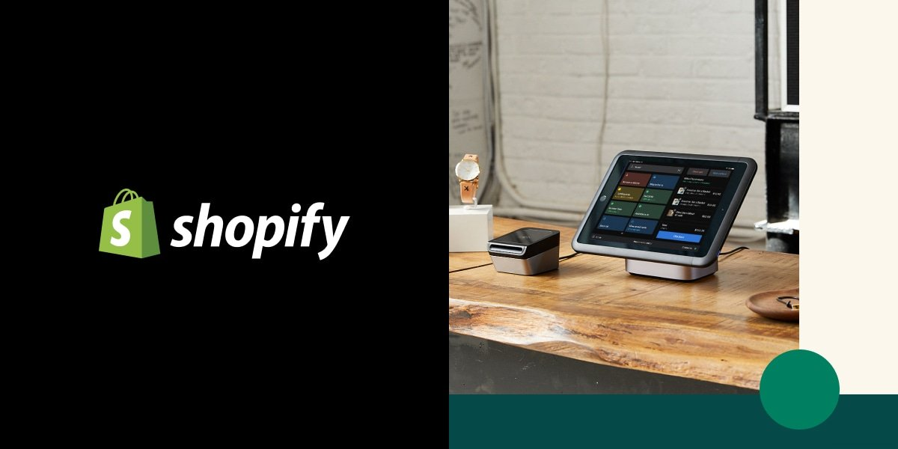
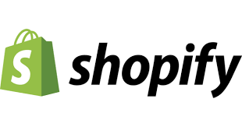
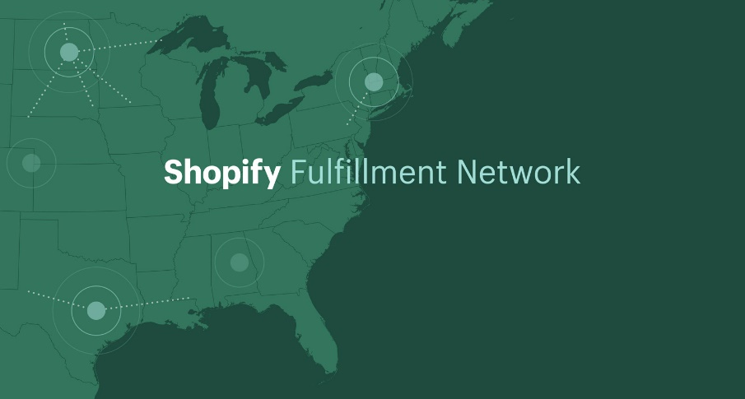
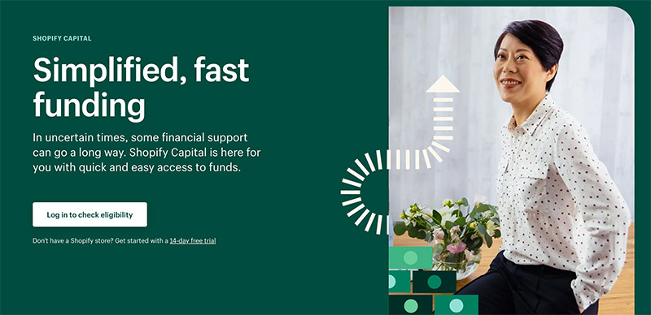
Shopify

Slide 32
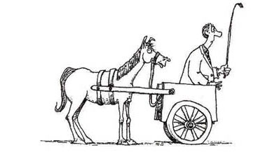

Slide 33
Your AI Applications
What role are you playing?
Can you play a role upstream and downstream in your customer’s journey?
Can you predict the next customer journey?
Can you shorten the customer journey?

Slide 34
AI Applications in Marketing & Finance
Recognizing New Forms of Risk with Machine Intelligence
Raghuram Iyengar, Miers-Bush, W’1885 Professor, Professor of Marketing and Faculty Director of Wharton Customer Analytics

Slide 35
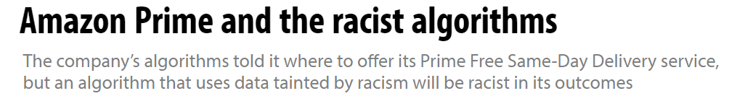
New Forms of Risk with Machine Learning
Understanding where the data is from
Amazon scraps secret AI recruiting tool
The AI tool ended up being biased against women

Slide 36
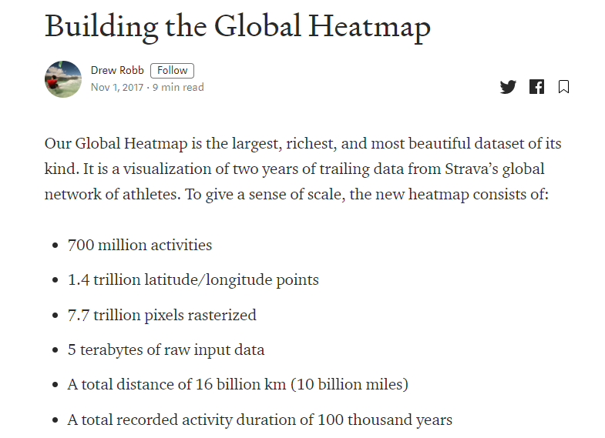
New Forms of Risk with Machine Learning
Datasets and privacy

Slide 37
New Forms of Risk with Machine Learning
How are you using machine learning?
How often is your data getting updated?
What parts of customer behavior are sticky and which parts have changed?
There is no data for “free”
You need a proactive approach

Slide 38
AI Applications in Marketing & Finance
Organizational Structure for Analytics
Raghuram Iyengar, Miers-Bush, W’1885 Professor, Professor of Marketing and Faculty Director of Wharton Customer Analytics

Slide 39
Four Main Models
Center of Excellence (COE) Model
Centralized Model
Functional Model
Dispersed Model

Slide 40
Centralized Model
A core unit serves the entire company
Advantages
Ability to work on cross-functional projects
Share ideas across analysts
High level of dependability for the company
Disadvantages
Workload and time constraints
Agility

Slide 41
Center of Excellence (CoE) Model
Analysts are based in business units and their activities are coordinated with a small central group
Advantages
Training is centralized
Coordination among teams is facilitated by one group
Disadvantages
CoE may not have enough control
Is there support within the org?

Slide 42
Functional Model
Analysts are placed within function(s) that dominate the analytics activity
Advantages
Analytics is concentrated where it can benefit the most
Disadvantages
Other functions may not get the support

Slide 43
Dispersed Model
Analysts are simply spread throughout the organization with no centralized support
Advantages
Some units may get to use analytics as they need it
Disadvantages
Many — this is not really a model at all

Slide 44
Which Model to Use?
It depends on the needs of the organization
Some amount of centralization is necessary as it helps with efficiency
Constantly monitor if the model is congruent with the analytics maturity level of the organization

Slide 45
AI Applications in Marketing & Finance
A Template for AI Transformation
Raghuram Iyengar, Miers-Bush, W’1885 Professor, Professor of Marketing and Faculty Director of Wharton Customer Analytics

Slide 46
A Template for AI Transformation
Set up an AI brain trust of 8-12 people in the organization (insiders and outsiders)
Brain trust identifies data assets within the organization and a set of activities that you can automate using ML/AI
Classify them into short-term and long-term initiatives
Construct a ML portfolio related to the short-term and long-term projects
Maybe 4-5 short-term and at least 1 long-term project
Figure out how the AI team will fit into the organization chart
Set up a risk management or audit process

Slide 47


